Slide 1
3D brush calculation update
01/10/2025

Slide 2
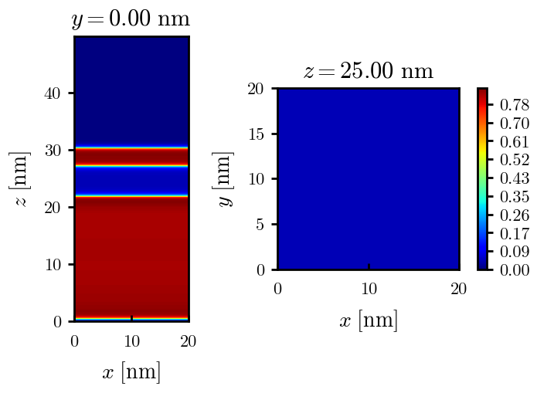
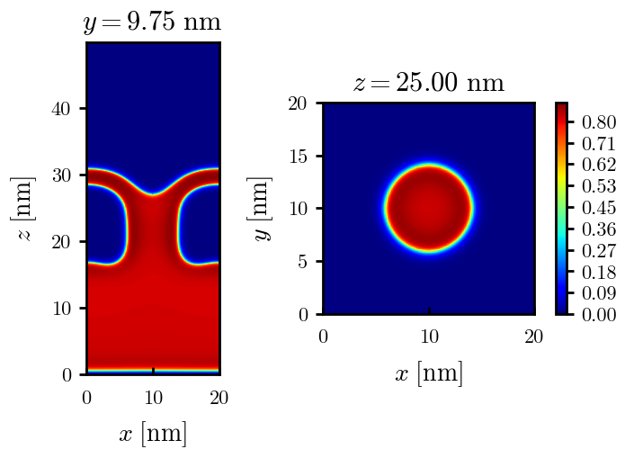
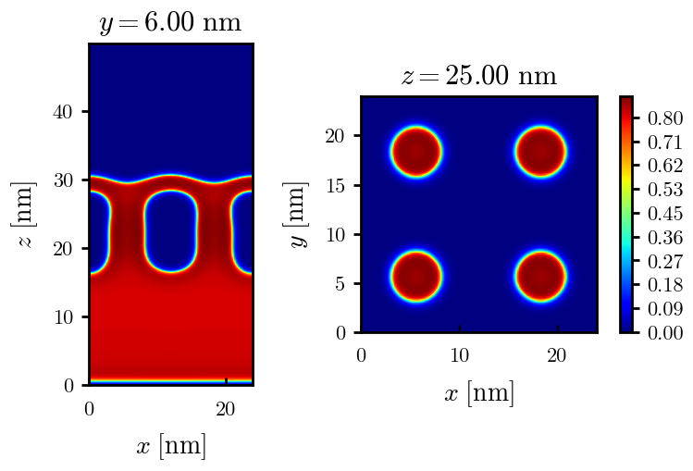
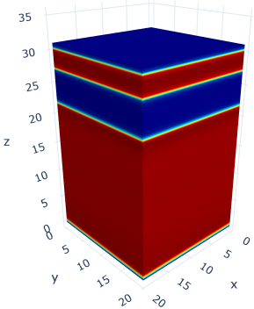
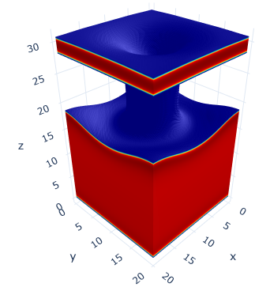
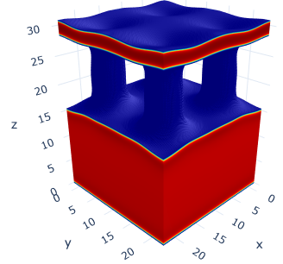
Morphologies found so far (alpha = 0.4, chi = 1.70, varying sigma)
2-layered morphology; same as 1D calculations
2-layered morphology with 1 condensed stem
2-layered morphology with 4 condensed stems
Note: dark blue here is for lower densities than other figures to show polymer in region btw layers

Slide 3
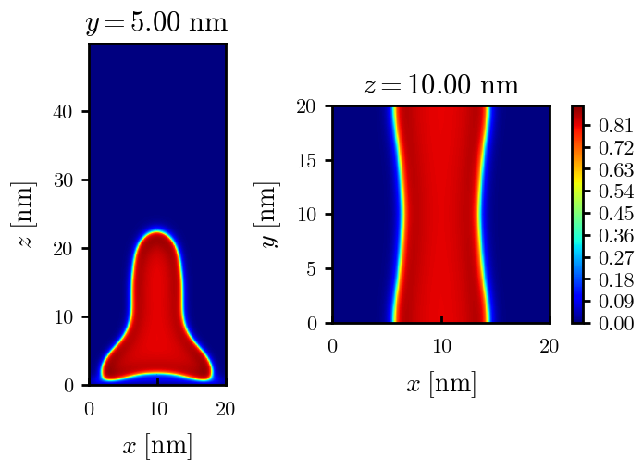
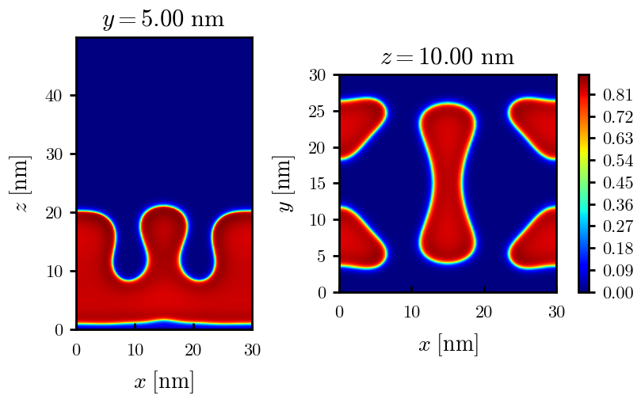
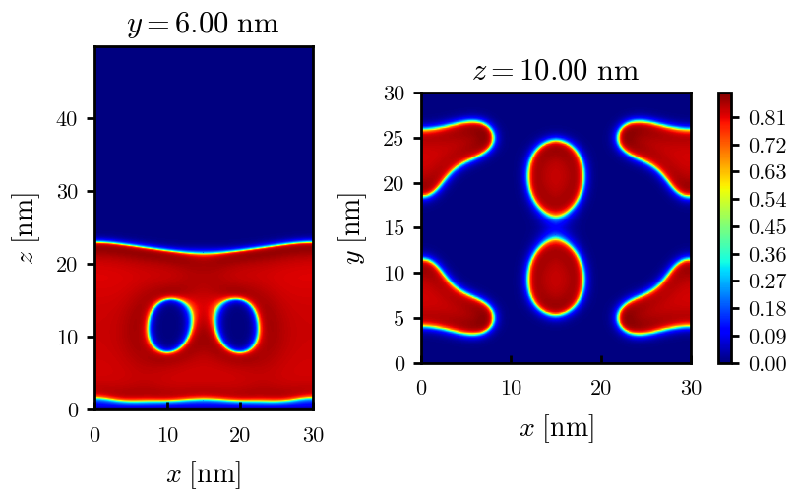
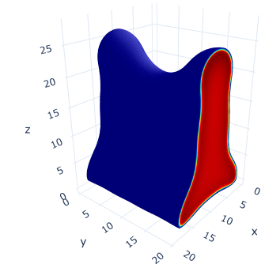
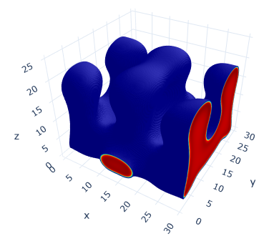
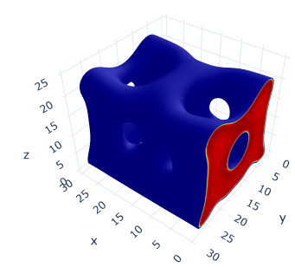
Morphologies found so far (alpha = 0.4, chi = 1.70, varying sigma)
Stripe
Maze (unsure)
Note: the below two could converge to the same morphology

Slide 4
Hypothesized stability (alpha = 0.4, chi = 1.70, varying sigma)
For lower chi, same morphologies plus more competing layered and grafted PN structures
Increasing grafting density
PN aggregates?
Isolated Micelle/PNs
2-layered + 1 neck
2-layered + 4 necks
2-layered homogeneous
Fully swollen
Stripe
Maze
In progress
Haven’t tried very high grafting densities yet
Note: Unsure if this will ever be minimum free energy morphology, only including here due to similarity to results of Carrillo and Dobrynin
Note: dark blue here is for lower densities than other figures to show polymer in region between layers

Slide 5
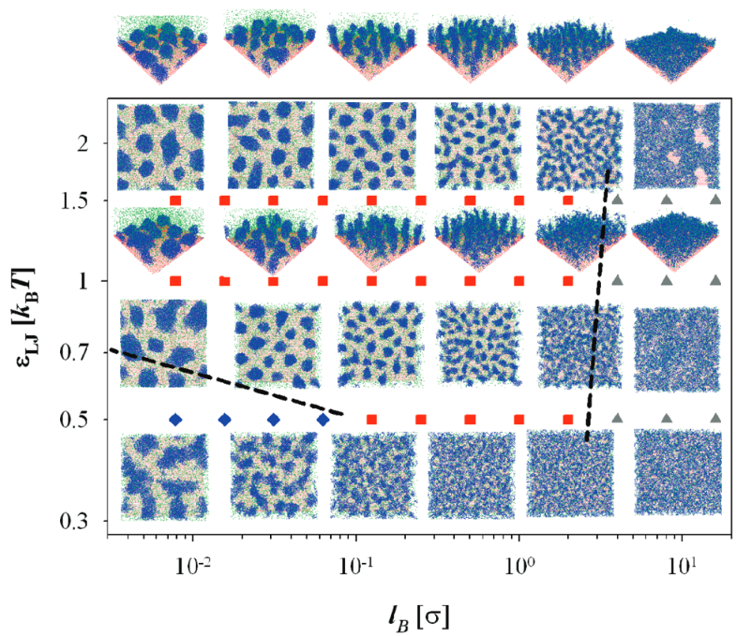
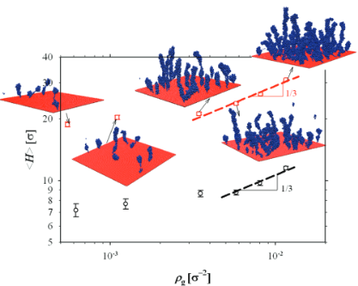
Other works on segregated PEBs
Carrillo and Dobrynin. Langmuir 2009.
Variety of parameters, finding cylindrical aggregates, maze-like aggregates, and layers. Maze-like could be similar to stripes and some of the layers seem to exhibit holes.
As grafting density is increased, the cylindrical aggregates grow vertically and loosely form pearl necklaces

Slide 6
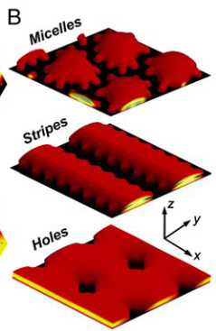
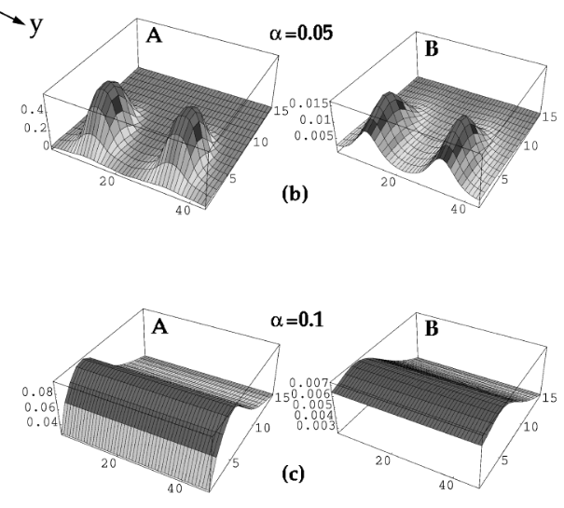
Other works on segregated PEBs
Tagliazucchi, Olvera de la Cruz, Szleifer. PNAS 2010.
Micelle, stripe, and hole morphologies for weak brushes but chain lengths are much lower, salt concentration is much higher. Polymers are also weak (e.g., pKa = 5)
“Hole” morphology is similar to the 2-layered morphologies with thick stems on the previous slide where the top layer is indented.
Additional work by Szleifer group (Prusty et al. Soft Matter 2020) on diblock PE brushes, finding micelles and stripes.
Zhulina, Singh, Balazs. JCP 1998.
Transition of pinned micelles to fully swollen brush. Counter-ion only system with N = 100 and chi = 1.0.
Calculations are done in 2D (Z-Y and translationally invariant in X) rather than 3D (in the plots, the vertical axis is polymer density).

Slide 7
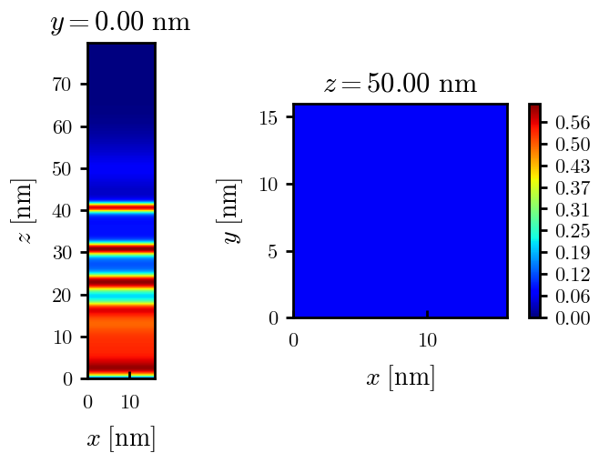
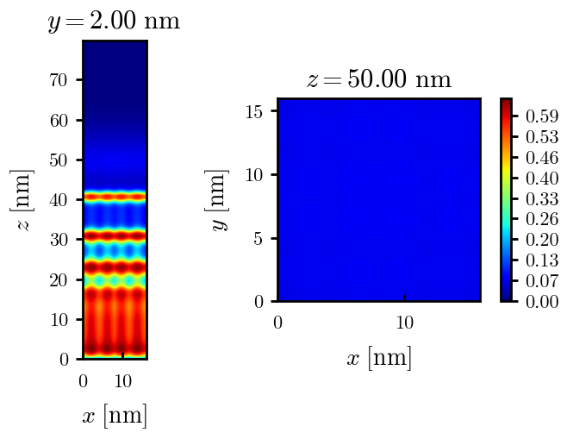
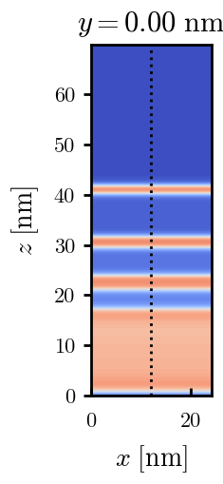

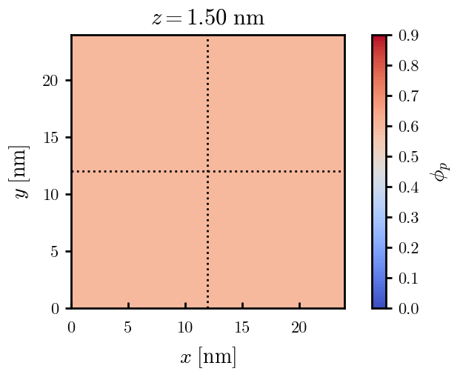
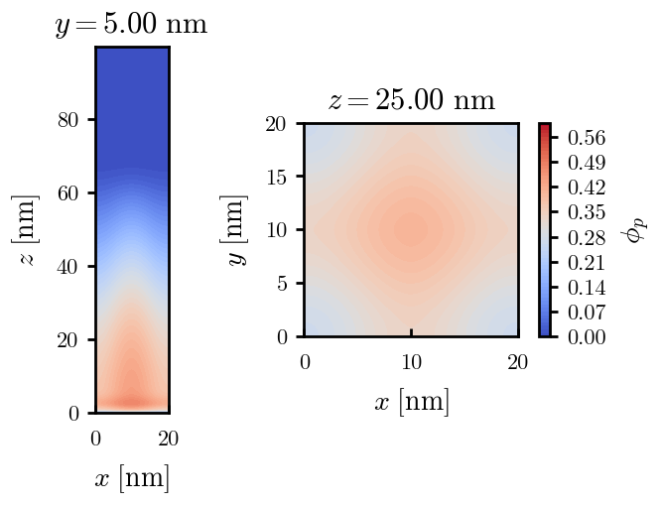
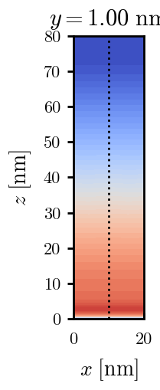
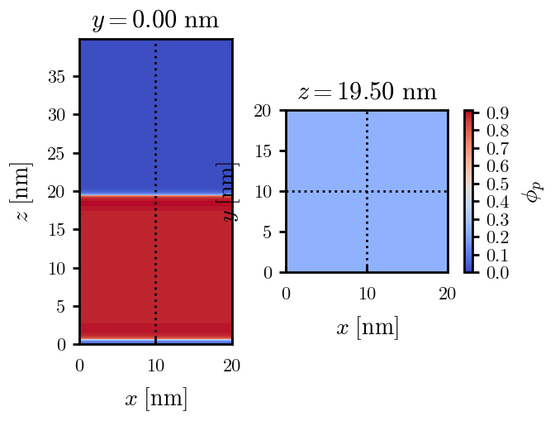
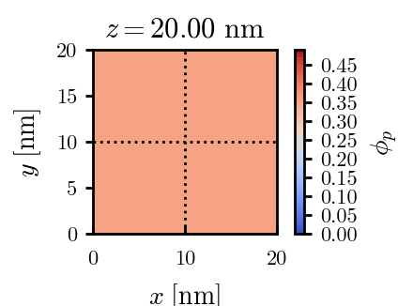
Other possible morphologies (stability needs to be confirmed)
Multi-layered at varying chi, same as 1D calculations
Grafted PNs (as discussed in Macromolecules reviewer responses)
4-layered
4-layered + outer swollen
Pinned micelle and fully swollen at low chi
Fully collapsed at high chi

